Slide 1

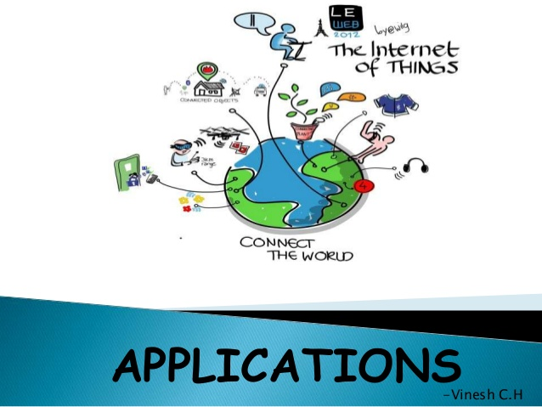
B.N.M. Institute of Technology Approved by AICTE, Affiliated to VTU, Accredited as grade A Institution by NAAC. All UG branches – CSE, ECE, EEE, ISE & Mech.E accredited by NBA for academic years 2018-19 to 2020-21 & valid upto 30.06.2021 Post box no. 7087, 27th cross, 12th Main, Banashankari 2nd Stage, Bengaluru- 560070, INDIA Ph: 91-80- 26711780/81/82 Email: principal@bnmit.in, www. bnmit.org
SKILL DEVELOPMENT PROGRAMME
on
Internet of Things
Organized by
Department of Computer Science & Engineering

Slide 2
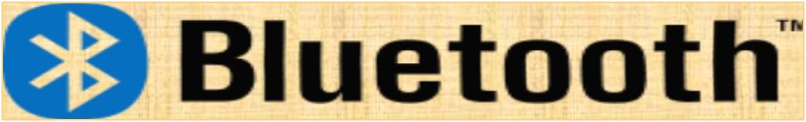
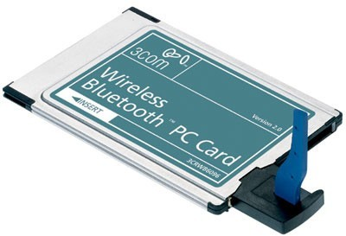
BLUETOOTH

Slide 3
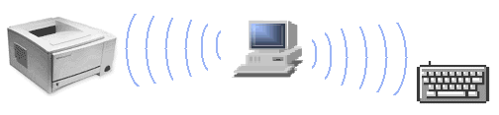
DEFINITION
Bluetooth is a method for data communication that uses short-range radio links to replace cables between computers and their connected units .

Slide 4
ORIGINATION OF “BLUETOOTH”
In 10th century Harald Bluetooth, the king of Denmark united Norway and Denmark into a single kingdom. Apparently he got that name from his penchant for blueberries.

Slide 5
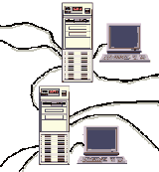
NEED FOR BLUETOOTH
A Cable Replacement Technology
It's wireless.
It's inexpensive.
You don't have to think about it.

Slide 6
APPLICATION EXAMPLES
A Bluetooth-mouse
A Bluetooth-keyboard
Cable-less connection to printers
Use e-mail while your portable PC is still in the briefcase!

Slide 7
HISTORY OF BLUETOOTH
In 1994, Ericsson Communication Ltd. started
Mobile
project
named “Bluetooth”.
In 1998, Bluetooth SIG was formed and it officially adopts the project name “Bluetooth” as the name of technology.
Frequency Hopping Spread Spectrum Technology was used for data transmission.

Slide 8
In 1999, Bluetooth 1.0 & Bluetooth
B Specification was released.
Problem of Hardware interoperability & compatibility between devices.
In 2000, Bluetooth headset and phone adaptor from Ericsson ; the first consumer product.
In 2003, Bluetooth 1.2 was released.
Improved resistance to radio interference
Ratified as IEEE 802.15.1-2005

Slide 9
In 2004, Bluetooth 2.0 with enhanced data rate (EDR) is released.
EDR uses combination of GPSK & PSK.
3
Mbps nominal & 2.1 Mbps practical data
transfer rate can be achieved.
Reduced complexity of multiple connection due to increased bandwidth.
Low power consumption through reduced duty cycle.
In 2006,Bluetooth SIG announced its selection of Wimedia alliance for integration with current wireless Bluetooth technology.

Slide 10
In Jun 2007, Nokia and Bluetooth SIG announced that Wibree will be a part of bluetooth Specification as an ultra low power bluetooth technology.
In July 2007, Bluetooth Specification is released.
Extended Inquiry Response
Sniff Subrating
Secure Simple Pairing
2.1 Core
Near field Communication (NFC) Cooperation

Slide 11
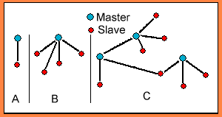
BLUETOOTH
DEFINITIONS
❑
❑
Single-slave
Multi-slave (up to 7 ”slaves” on one master)
Scatternet
❑

Slide 12
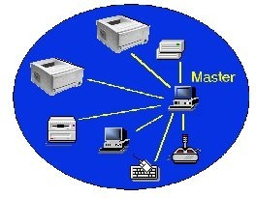
PICONETS
A set of BLUETOOTH
devices sharing a common channel is called a PICONET

Slide 13
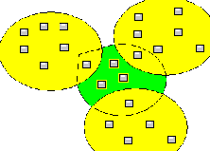
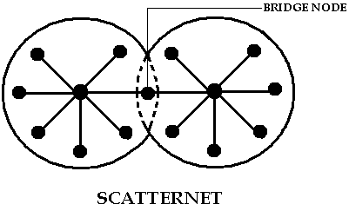
SCATTERNETS
Scatternets are two or more independent and non-synchronized piconets that communicate with
each making nodes.
other by
bridge

Slide 14
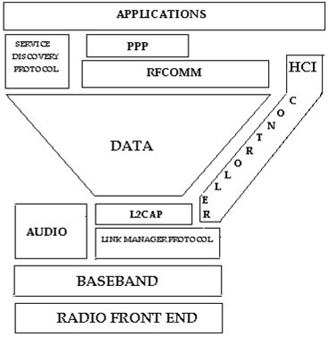
STRUCTURE
STACK

Slide 15
COMPONENTS OF STACK
Radio Front End (RF)
Defines characteristics of RF, frequency bands, channel arrangements & receiver sensitivity level.
Logical Link Control & Adaptation Protocol (L2CAP)
For transporting bigger data products to higher layer
Service Discovery Protocol (SDP)
To query and discover services supported by peer Bluetooth device.

Slide 16
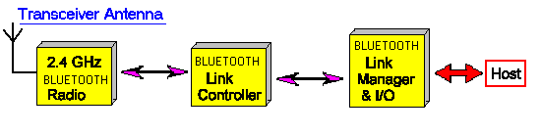
Link Manager Protocol (LMP)
PICONET, master slave role assignments and link configuration.
Security configuration by device authentication using secret key.
RFCOMM
Provides transport capabilities for high level services.

Slide 17
THE CONNECTION ESTABLISH
INQUIRY
PAGING

Slide 18
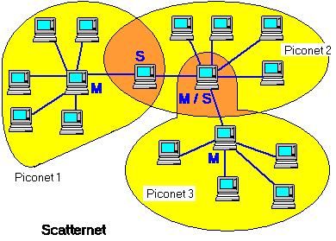
CREATION OF A SCATTERNET
A Master or Slave can become Slave in another piconet by being paged by the Master in this other piconet.

Slide 19
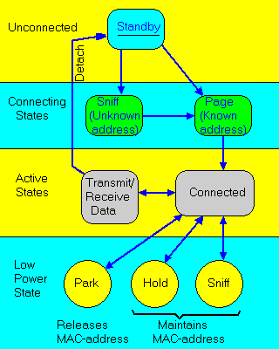
NETWORK FORMATION AND CONTROL

Slide 20
BLUETOOTH’S
SECURITY
Safer transmission of data in Bluetooth 2.0 and in later versions.
■
❖
❖
BLUEJACKING BLUESNARFFING
■
Bluetooth´s Error Correction Schemes
■
■
FEC (Forward Error Correction)
ARQ unnumbered scheme (Automatic Repeat Request).

Slide 21
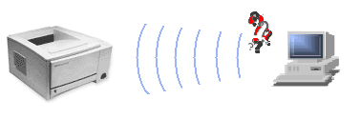
IS BLUETOOTH DANGEROUS ?
Bluetooth carrier wave uses same frequency as that of microwave oven (2.402 GHz to 2.48 GHz).

Slide 22
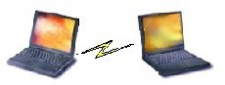
BLUETOOTH’S COMPETING TECHNOLOGIES
Is Bluetooth a Wireless LAN (WLAN)?
INFRARED TECHNOLOGY

Slide 23
FUTURE OF BLUETOOTH
BROADCAST CHANNEL
Enables Bluetooth information points.
TOPOLOGY MANAGEMAENT
Enables automatic configuration of piconets
ALTERNATIVE MAC PHY
For transporting bluetooth profile data.
For sending lots of data at high speed.
QOS IMPROVEMENTS
Transmission at higer quality

Slide 24
BIBLIOGRAPHY
WIKIPEDIA
www.bluetooth.com
E-book on Wireless Lan Techniques - RF, Wi-Fi, Bluetooth
E-book on Introduction of Bluetooth Wireless Technology By- INTEL
E-book on Bluetooth Security

Slide 25
Wireless Sensing Technologies
Bluetooth
Wi-Fi
Zigbee
RFID
LoRa

Slide 26
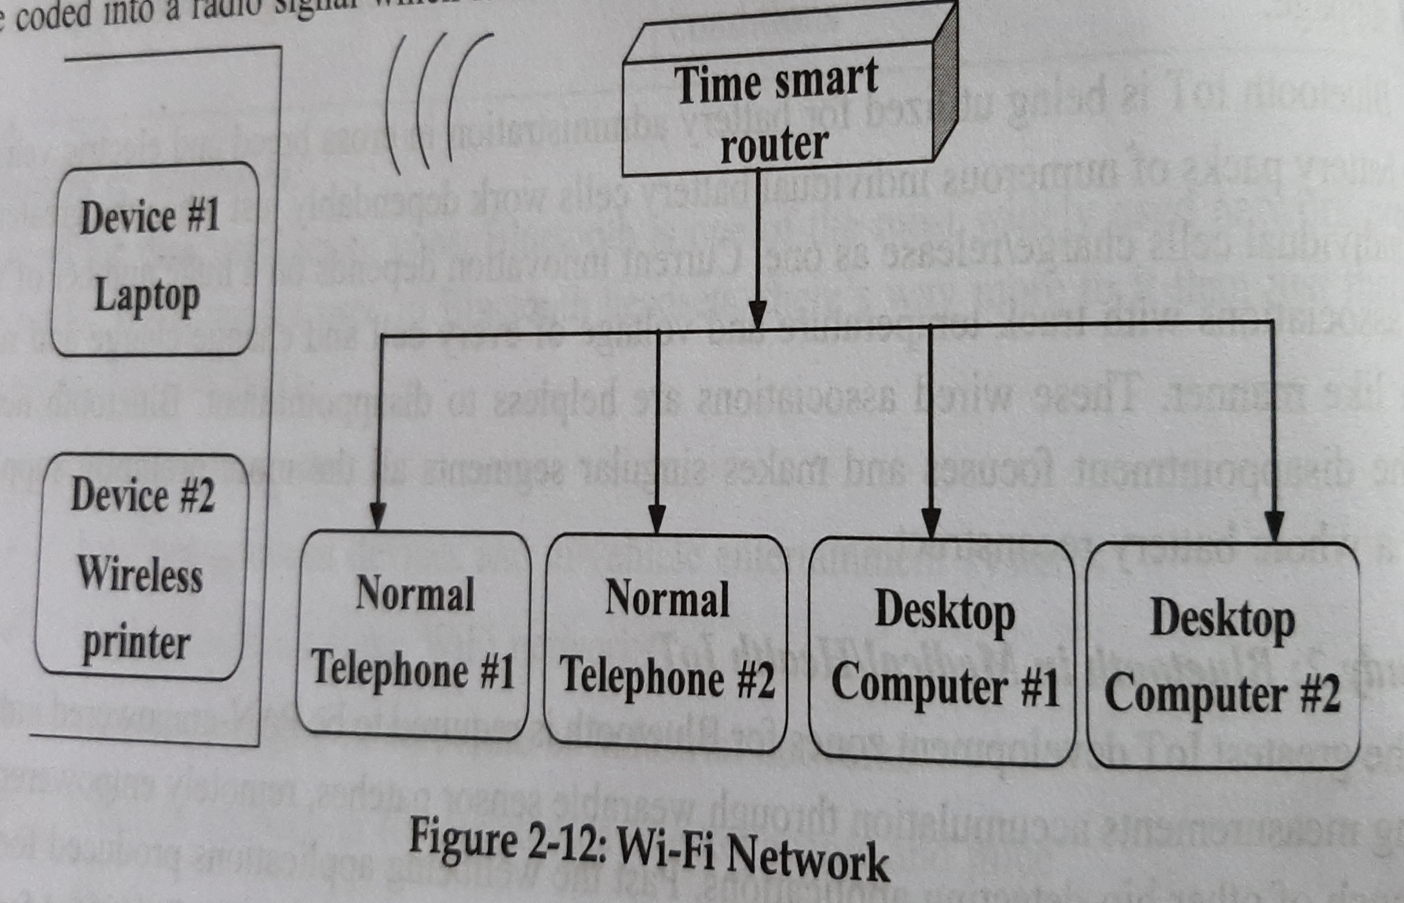
Wi-Fi Network

Slide 27
Different Types of Wi-Fi
Wi-Fi-802.11a
Wi-Fi-802.11b
Wi-Fi-802.11g
Wi-Fi-802.11n

Slide 28
Pros and Cons of Wi-Fi
Pros:
Wireless Ethernet
Extended Access
Cost Reduction
Mobility
Flexibility

Slide 29
Cons:
Security
Health Concerns
Signal Range

Slide 30
Application of Wi-Fi
Educational System
Automotive Applications
Home Applications
Industrial Applications
Military Applications

Slide 31
Zigbee
Zigbee consists of three devices:
Zigbee Coordinator
Zigbee Routers
End devices

Slide 32
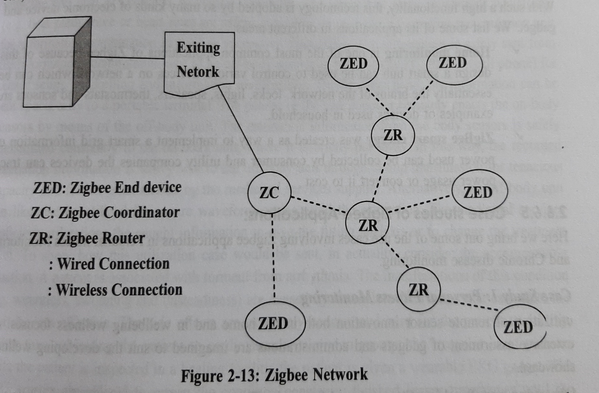
Zigbee Network

Slide 33
Pros and Cons of Zigbee
Pros:
Simple and easy network setup
No central controller
Scalable Network
Remote monitoring of appliances is easy

Slide 34
Cons:
Not secure compared to Wi-Fi
Limited Coverage
Its prone to attack by unauthorized people
Incurs more cost if replacement of the zigbee compliant device occurs.

Slide 35
Applications of Zigbee
Home Monitoring
Zigbee Smart Energy

Slide 36
Case studies of Zigbee Applications
Case Study 1: Personal Fitness Monitoring
Case Study 2: Chronic Disease Monitoring

Slide 37
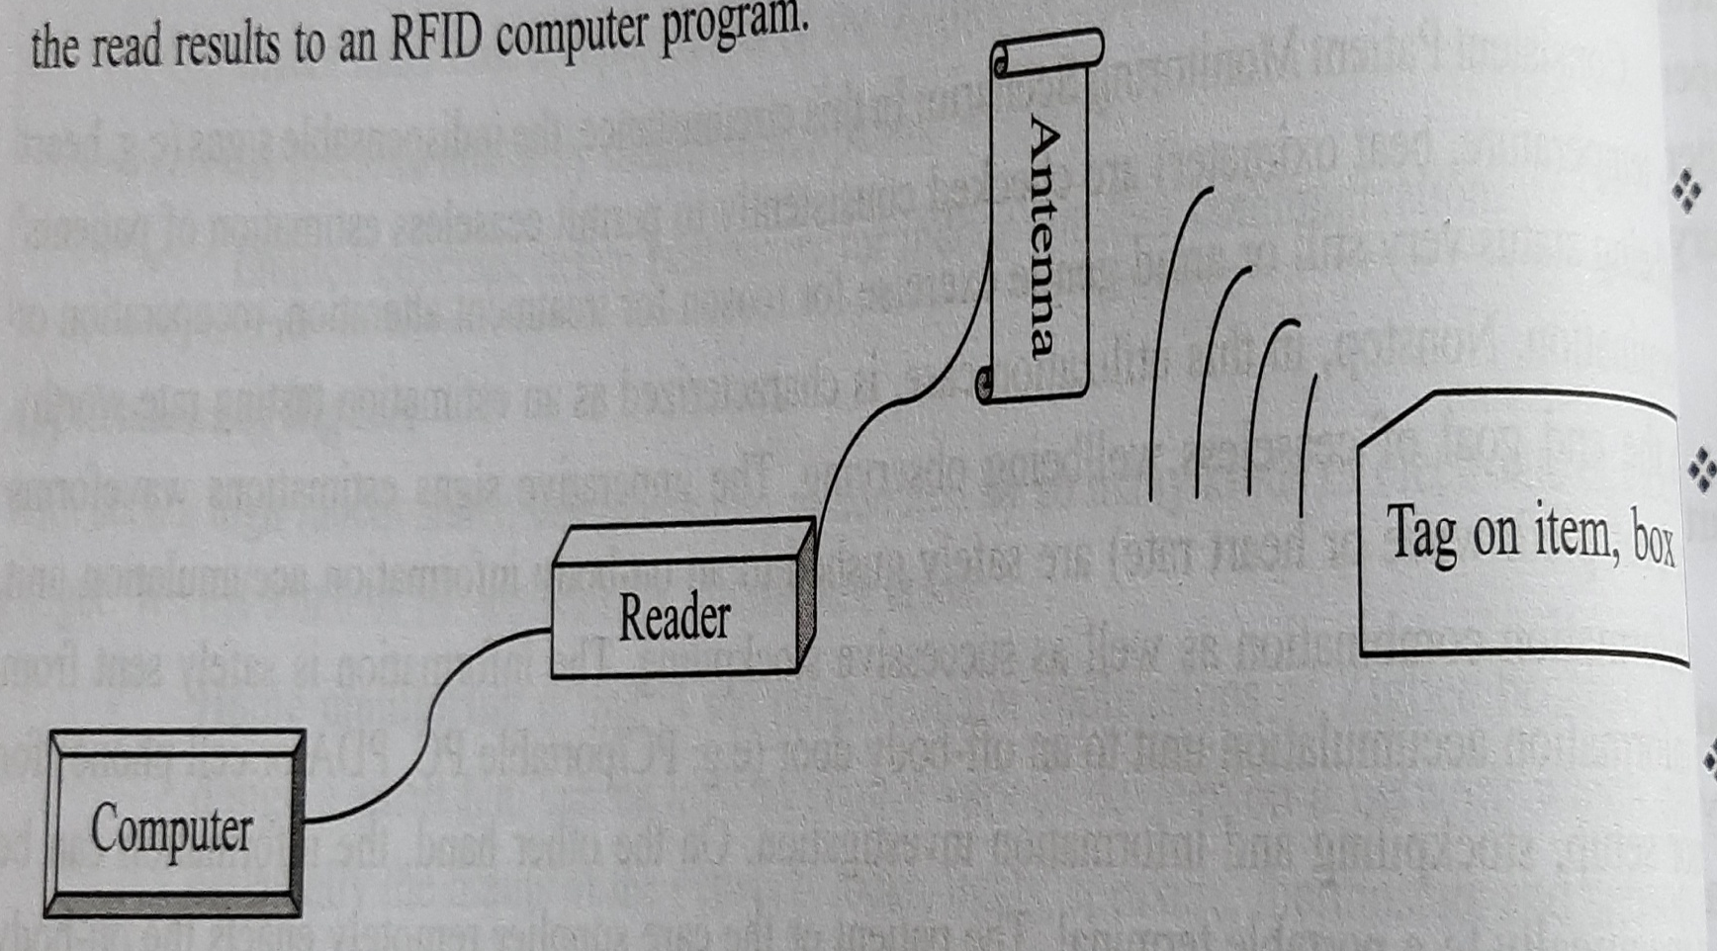
RFID (Radio Frequency Identification Module)

Slide 38
Pros and Cons of RFID
Pros:
RFID tag and reader should not be in LOS to make the system work.
ID and its location is provided to the reader.
Used to track luggage and can monitor health history of patients.

Slide 39
Cons:
RFID causes cost of batteries.
Easily tapped or intercepted.
Coverage range is limited to 3m.

Slide 40
Applications of RFID
Asset tracking
Supply chain management
Manufacturing
Retailing
Payment systems
Security access and Control

Slide 41
Case Studies of RFID Applications
Case Study 1: Inventory management
Case Study 2: Munich Public Library

Slide 42
LoRa
LoRa Feature and its Specification
Specification | LoRa Feature
Range | 2-5Km Urban
Frequency | ISM 868/15 MHz
Standard | IEEE 802.15.4g
Capacity | One LoRa gateway takes thousand of Nodes
Battery | Long battery life
LoRa Physical Layer | Frequency, power and gateways
Modulation | SSM based on FM pulses which vary

Slide 43
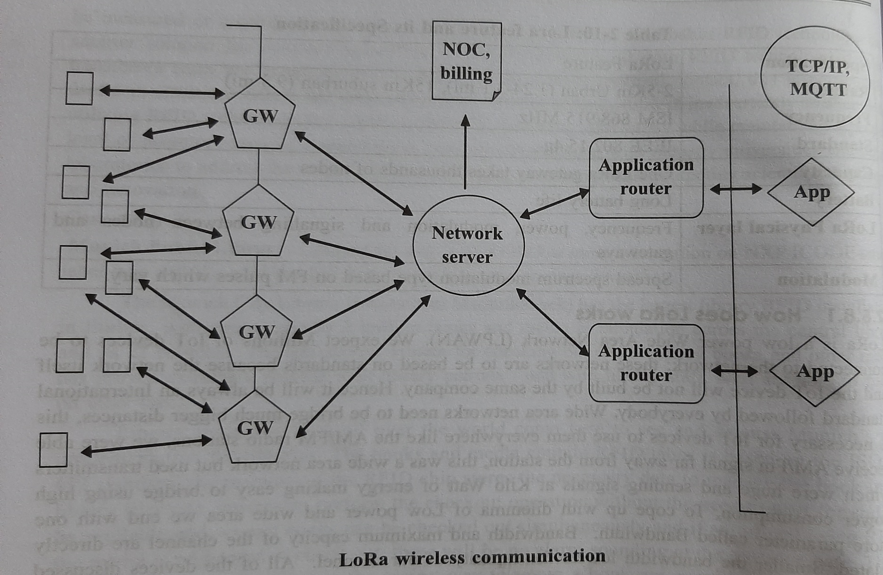
LoRaWAN Network

Slide 44
Pros and Cons of LoRa
Pros:
Easily deployable
Widely used in IoT/M2M applications
Consumes less power and battery serves for longer duration.
It uses 868 MHz/915 MHz band.

Slide 45
Cons:
It can be used for applications using low data rate about 27Kbps.
LoRaWAN network size is limited based on parameter – duty cycle.
Application requires low latency and bounded jitter.

Slide 46
Applications of LoRa
Air Pollution Monitoring
IoT systems for agricultural processing
Monitor animals
Sensors on medical fridge

Slide 47
Case Studies of LoRa Applications
Case Study 1: Precision Farming
Case Study 2: Item Location
Case Study 3: Water Flow Monitoring

